Slide 1
Electronics & Electricity
Unit 6 – TinkerCAD Circuits
Section 2 – TinkerCAD Breadboards

Slide 2
TinkerCAD Breadboards
TinkerCAD Breadboards

Slide 3
The big idea
Familiarity with TinkerCAD Circuits
Designed circuits in a virtual environment
Circuit design both series and parallel
Virtual breadboard usage

Slide 4
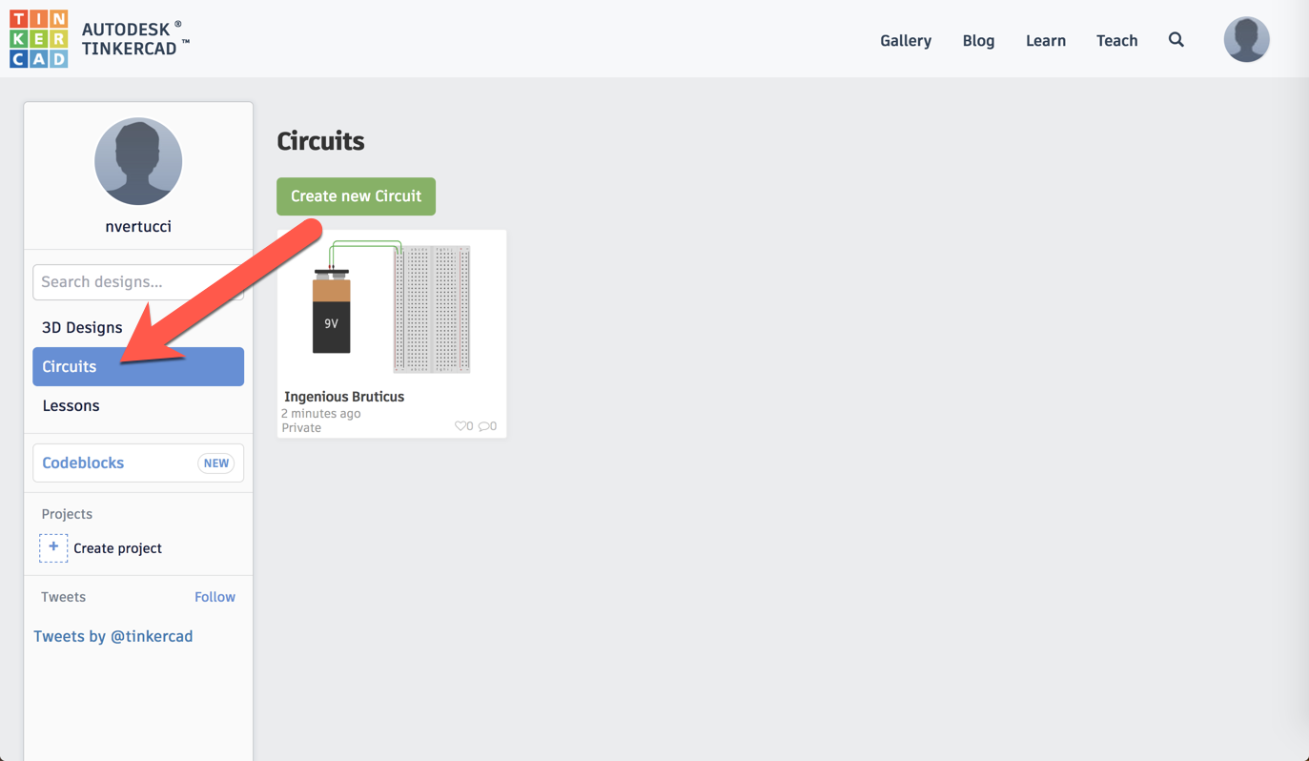
TinkerCAD Circuits

Slide 5
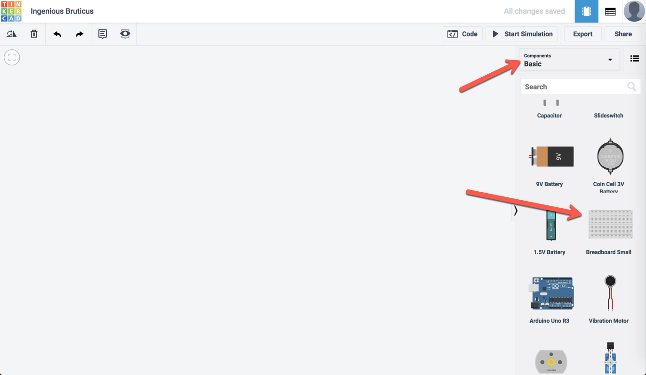

Slide 6
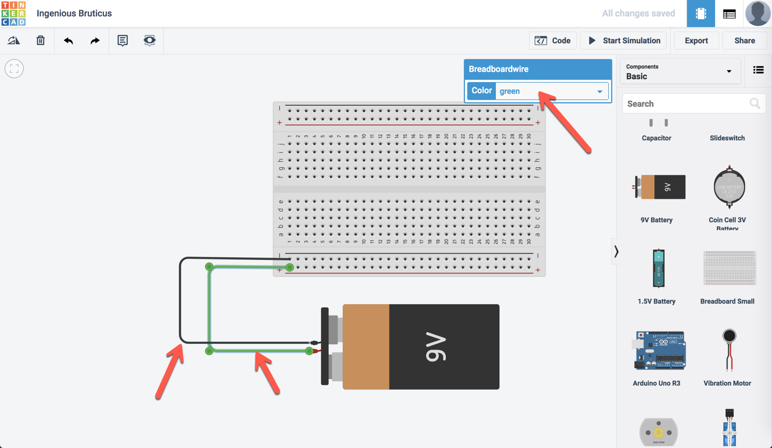

Slide 7
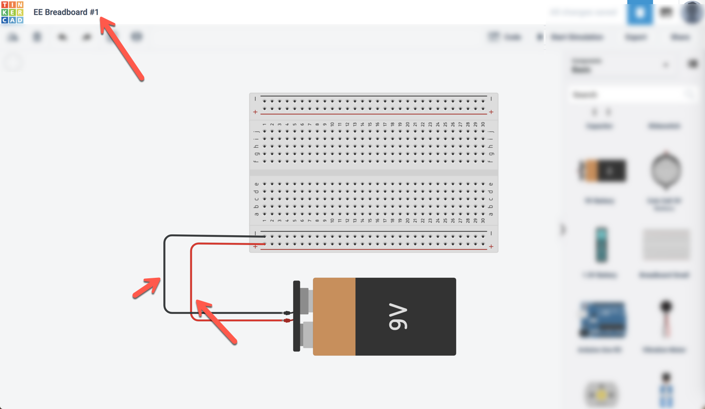

Slide 8
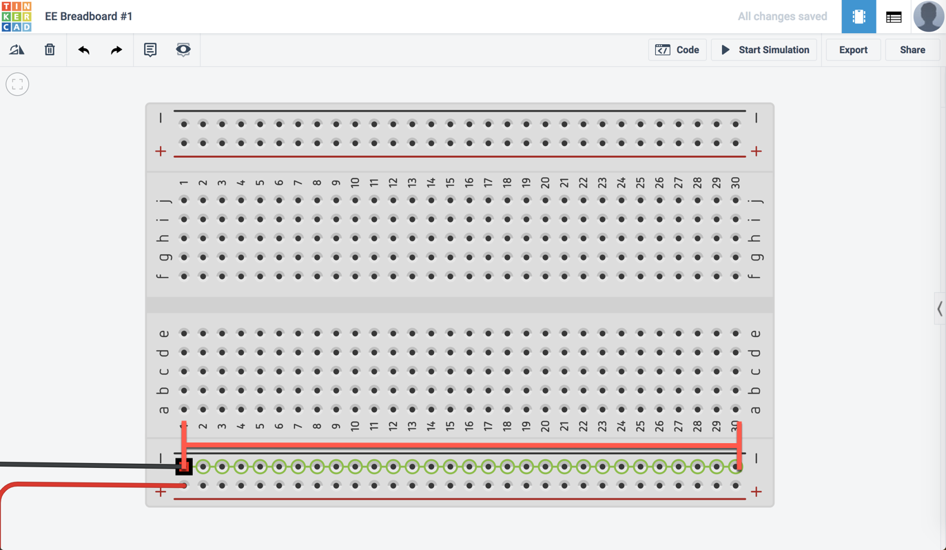

Slide 9
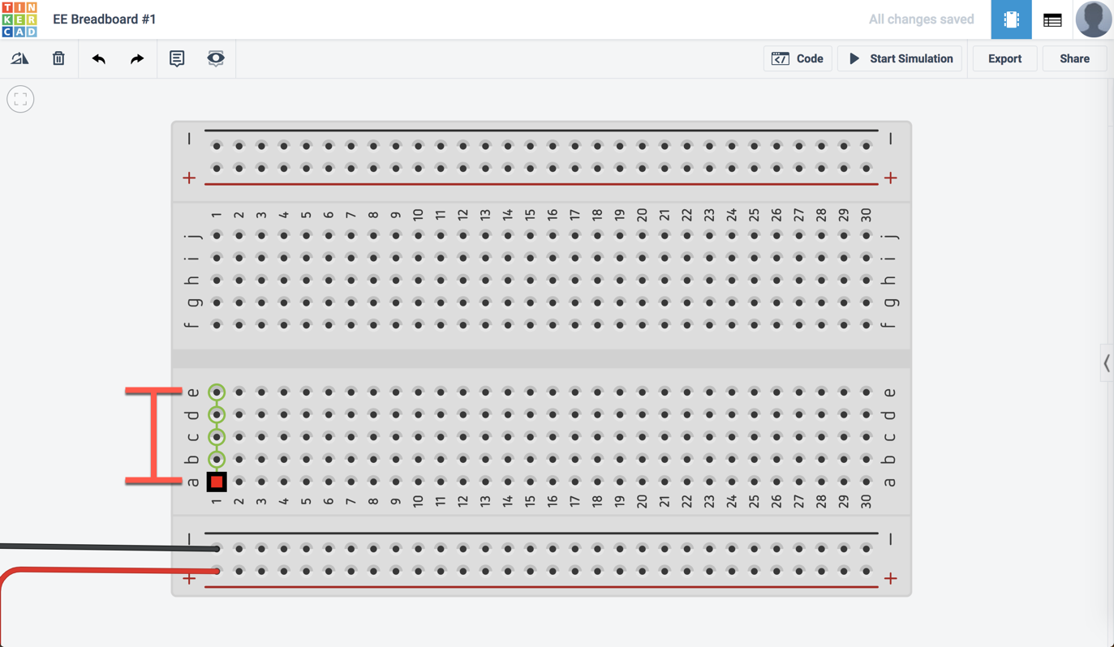

Slide 10
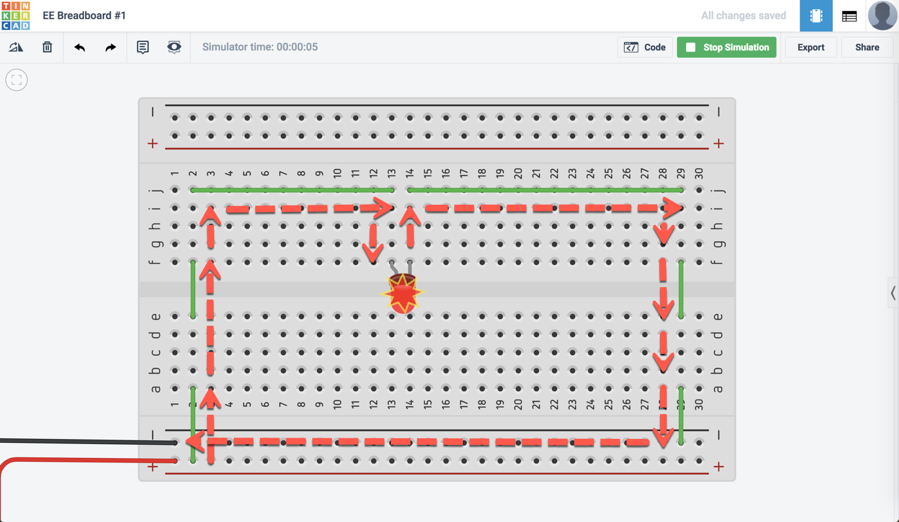

Slide 11
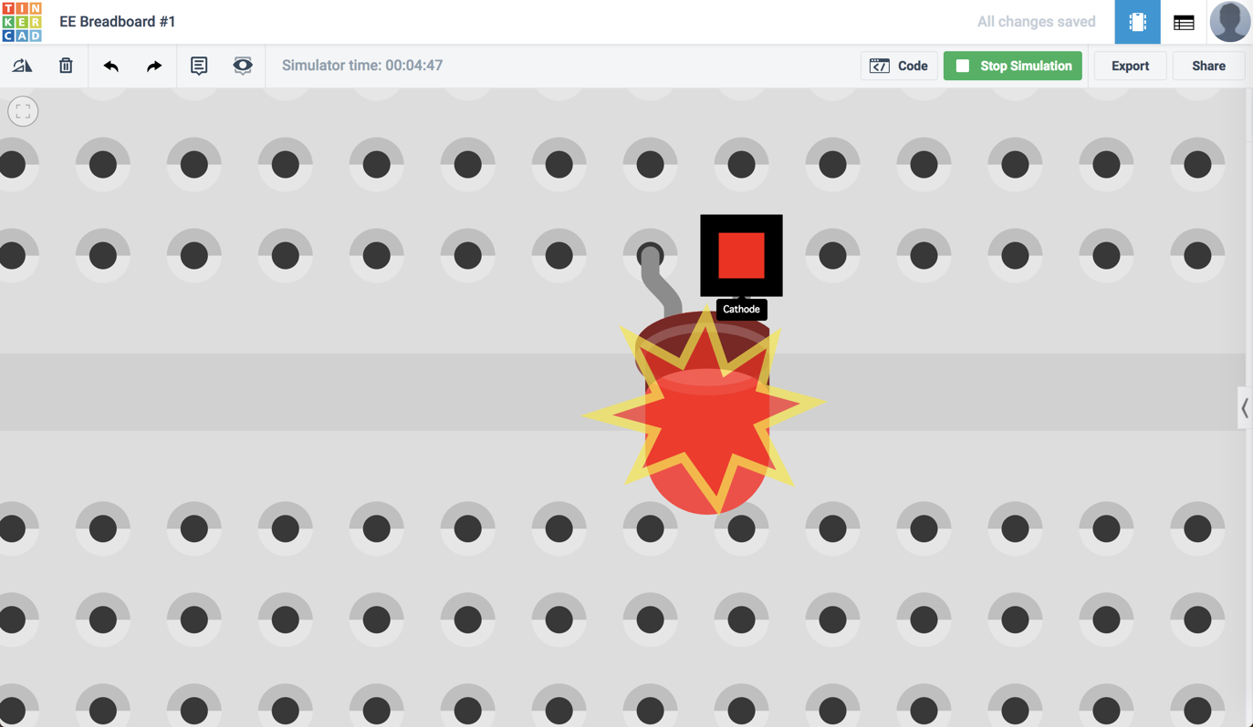

Slide 12
TinkerCAD EE#1
Requirements for TinkerCAD EE#1
Create a series circuit with a 9V source
Include a push button and a single (1) LED
Your series circuit should successfully light the LED when the push button is enabled

Slide 13
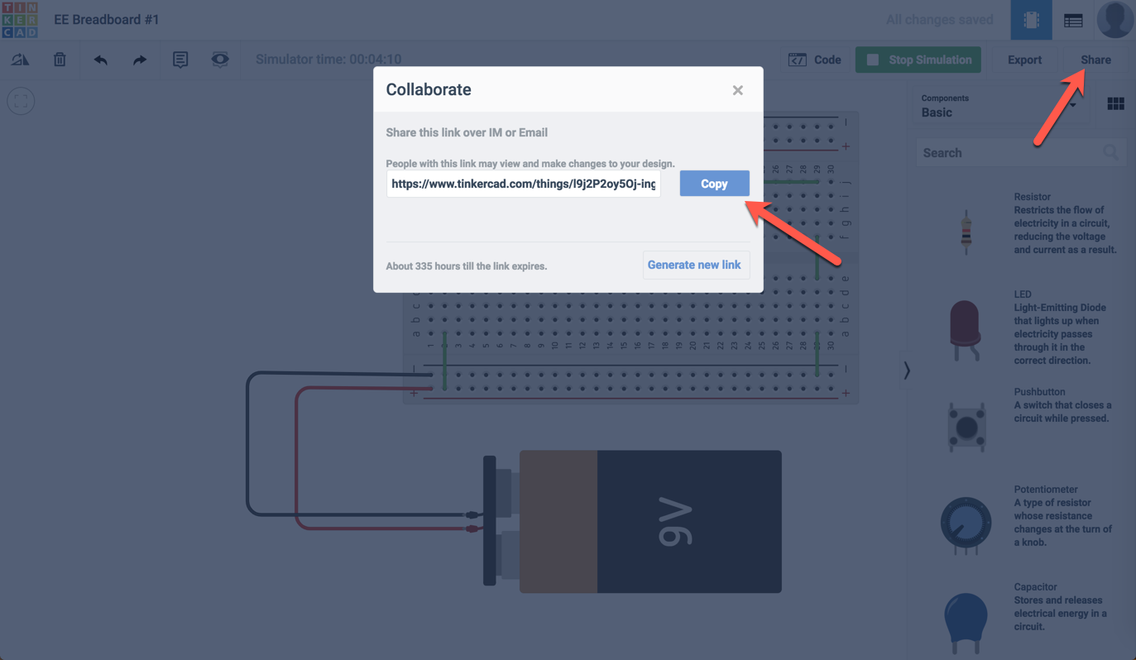

Slide 14
Workday Wednesday
Complete Electricity & Electronics #1 via TinkerCAD
Be sure to share the LINK when completing the Classroom assignment in the comments
BOTH group members must complete the assignment in Classroom

Slide 15
Breadboard Review
Breadboards are one of the most fundamental pieces when learning how to build circuits
Previously you would have had to build circuits by using a strategy called wire-wrapping
Wire wrap is a process that involves wrapping wires around conductive posts attached to a perfboard (a.k.a. a protoboard)

Slide 16
Why called a breadboard?
Many years ago, when electronics were big and bulky, people would grab their mom’s breadboard, a few nails or thumbtacks, and start connecting wires onto the board to give themselves a platform on which to build their circuits.

Slide 17
Why use a breadboard?
An electronics breadboard (as opposed to the type on which sandwiches are made) is actually referring to a solderless breadboard.
These are great units for making temporary circuits and prototyping, and they require absolutely no soldering.

Slide 18
TinkerCAD EE#2
Requirements for TinkerCAD EE#2
Create a parallel circuit with a 9V source
Include two (2) switches, one each powering a single LED
Your parallel circuit should successfully light the LED when the switch is enabled
You should be able to turn on a single LED at a time or even BOTH!

